Slide 1


Python Coding Session Data Visualization
Introduction to Implementation Details and Usage

Slide 2

Introduction
Data visualization with Python involves using Python and libraries like Matplotlib, Seaborn, and Plotly to create various charts and graphs. Python libraries make data preparation easier, and you can create line charts, bar charts, scatter plots, and more. Customization, interactivity, and integration with other tools are key features.

Slide 3
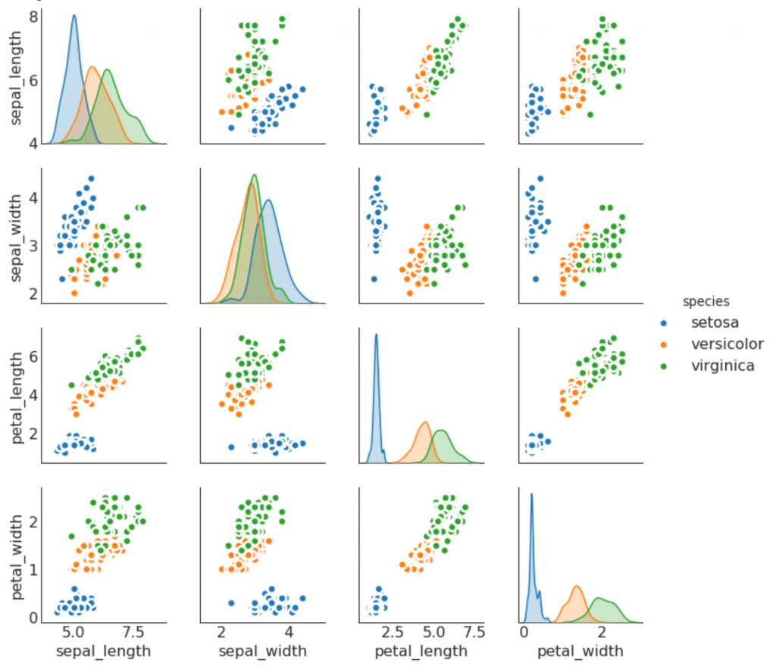
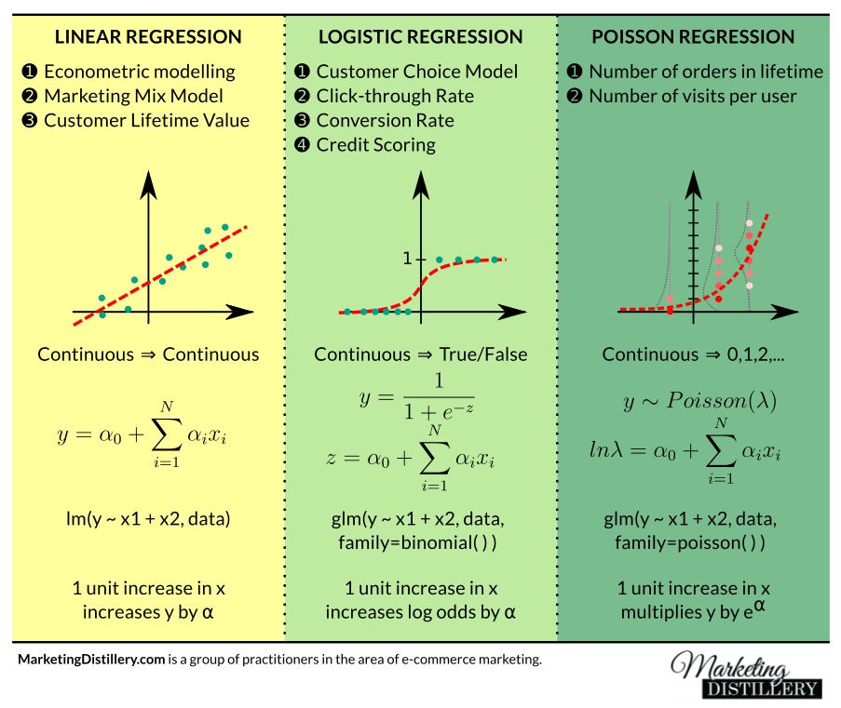
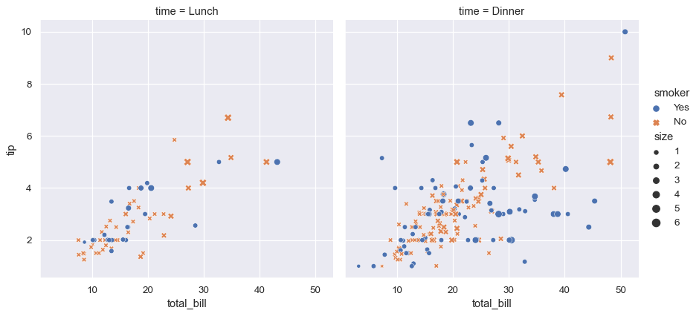
Why data visualization

Slide 4
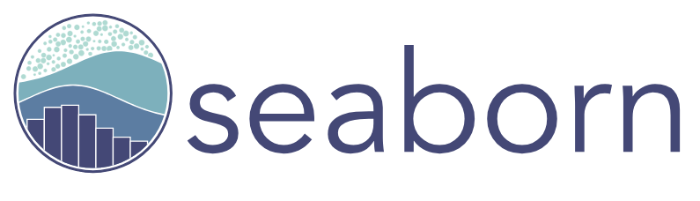


Existing Libs
Matplotlib: Matplotlib is one of the foundational libraries for creating static, animated, and interactive visualizations. It provides extensive control over plot elements and is highly customizable.
Seaborn: Seaborn is built on top of Matplotlib and offers a high-level interface for creating aesthetically pleasing statistical graphics.
Plotly: Plotly is a versatile library for creating interactive and web-based visualizations. It supports a wide range of chart types, including scatter plots, bar charts, line charts, and geographic maps. Plotly can be used in both Python and JavaScript environments.

Slide 5
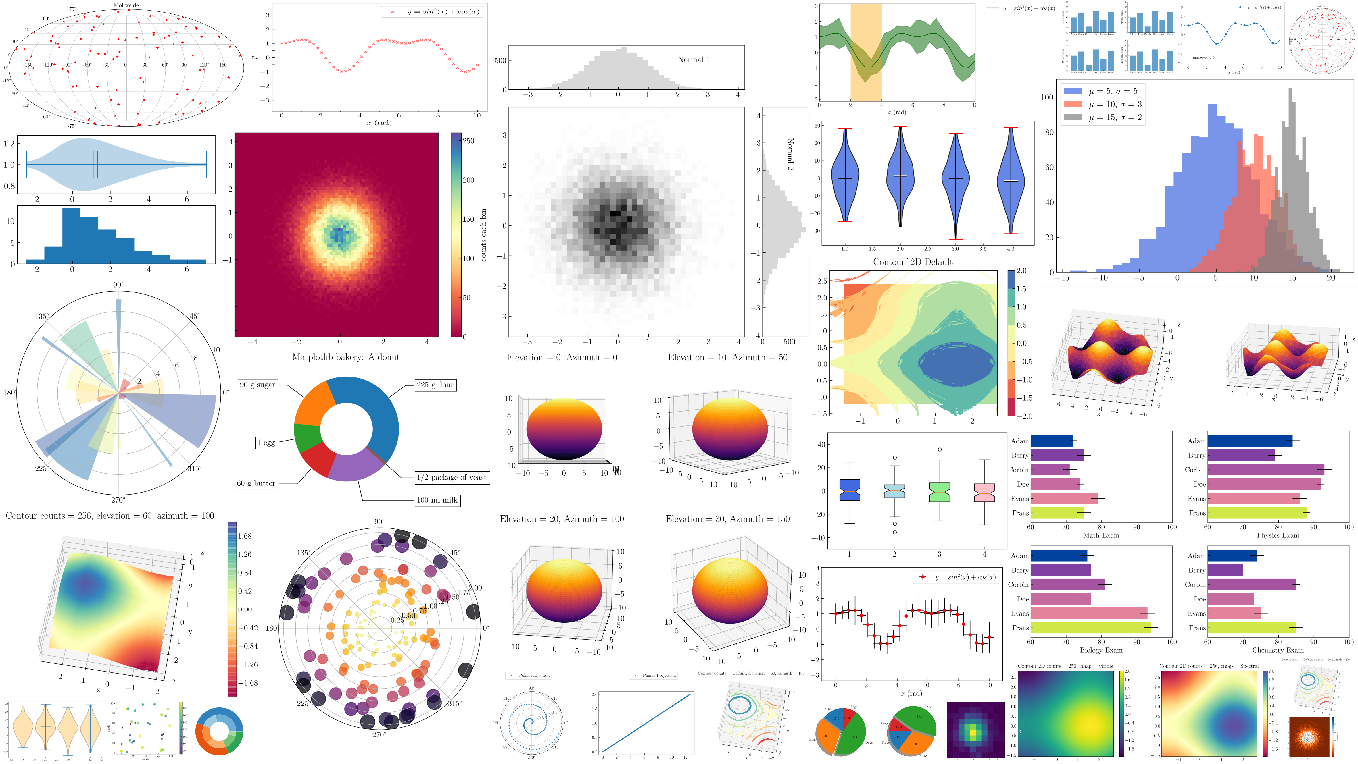

Slide 6
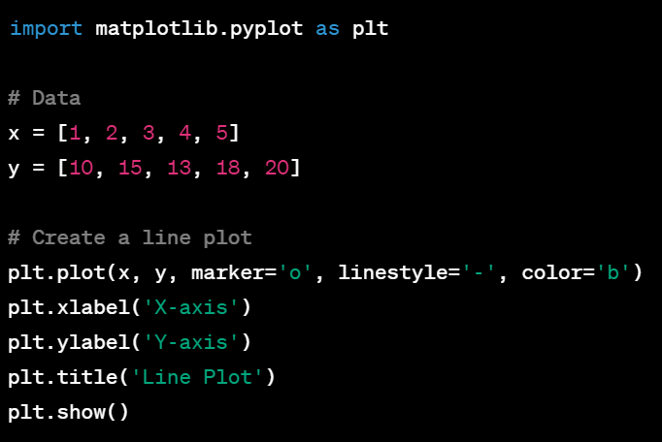
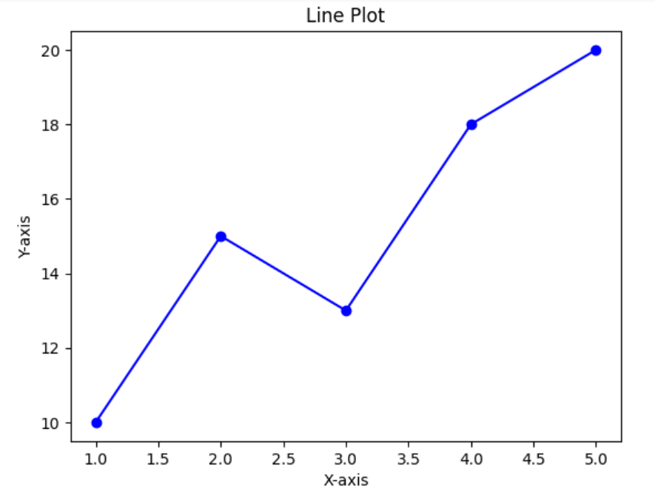
Examples

Slide 7
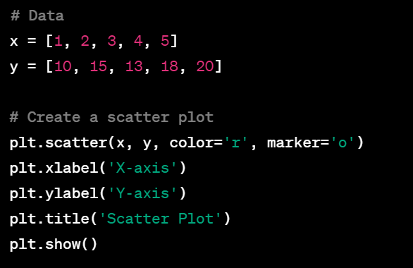
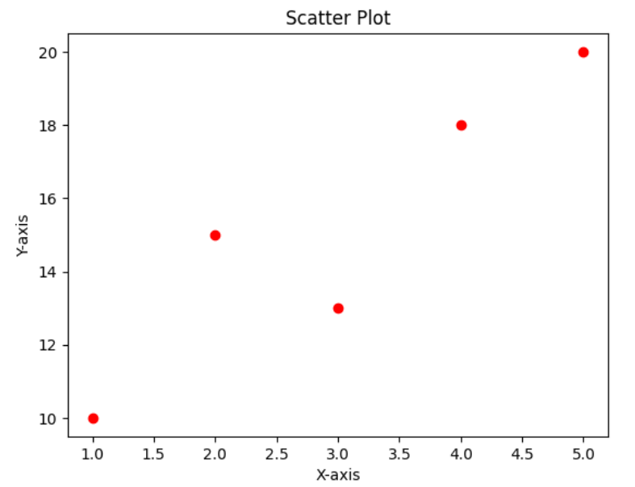
Examples

Slide 8
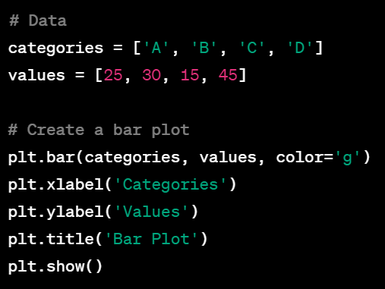
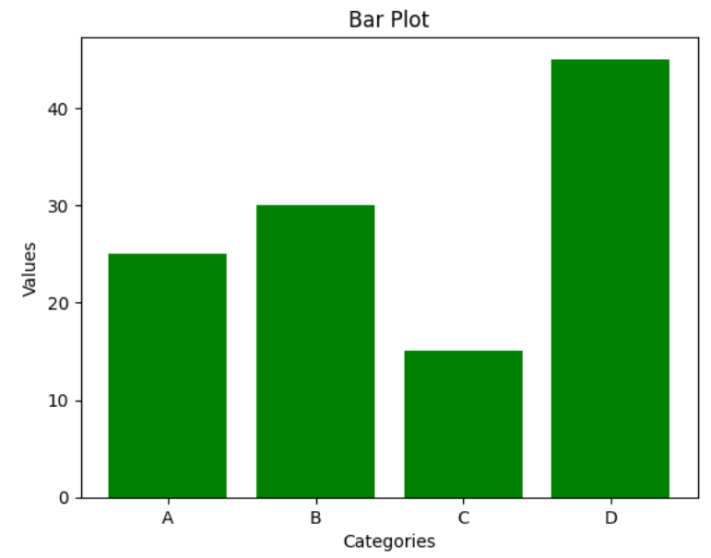
Examples

Slide 9
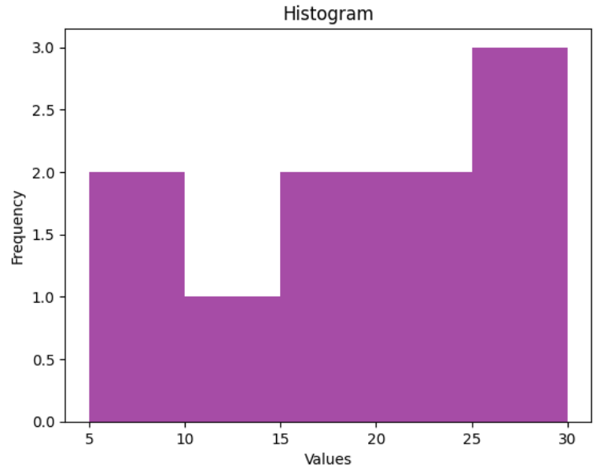
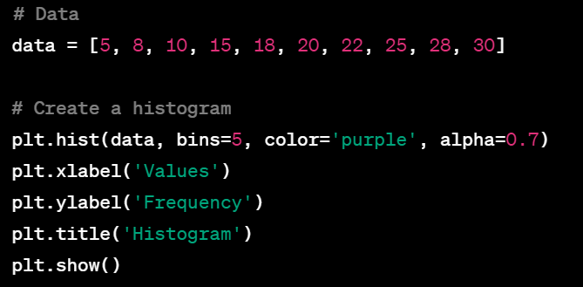
Examples

Slide 10
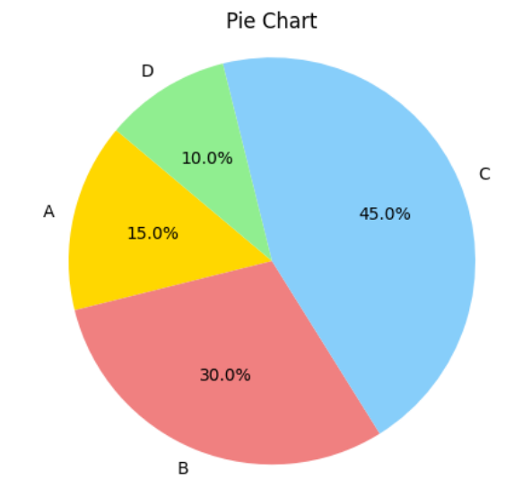
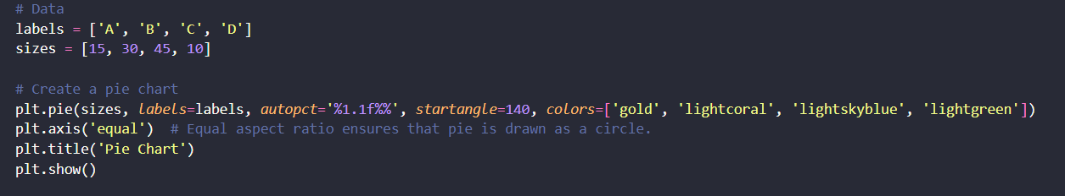
Examples

Slide 11
Exercises
Exercise 1: Line Plot with Multiple Lines
Task: Create a line plot with two or more lines on the same graph.
Exercise 2: Histogram
Task: Create a histogram to visualize the distribution of a dataset.
Exercise 3: Pie Chart
Task: Create a pie chart to represent the composition of a whole.

